Slide 1
Dealing with Data
Prof. Michael Ketzenberg

Slide 2
Agenda
Data and Data Sources
Preliminary Data Planning
Issues and Pitfalls Dealing with Data
Building an S&P Universe of Stock Data

Slide 3
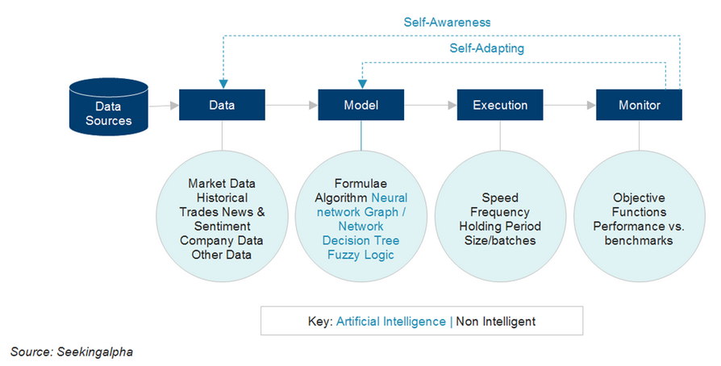
A Conceptual Model of Systematic Trading

Slide 4
Types of Data
System decisions are limited by the data used.
Price and volume data are natural and generally definitive, but there is a multitude of other valid information that might also be used.
Some of this data is easily included, like fundamental data or price data from companies in the same sector or an orthogonal one.
Other data, like U.S. economic data may add value, but may be inconvenient to obtain and certainly less timely
Additional data may be unstructured like text, web pages, social media, etc.

Slide 5
A Few Things to Keep in Mind About Data
More is better. It is a mantra.
No data is too old to use. Your strategy needs to adapt over time.
Data has multiple uses:
Training
Testing
Validating

Slide 6
Data Sources
Free:
Yahoo: http://finance.yahoo.com/
Nasdaq Data Link: https://data.nasdaq.com/
Alpha Vantage: https://www.alphavantage.co/
SimFin Project: https://simfin.com
Pay to play:
Tick Data, Inc: http://www.tickdata.com
Bloomberg: http://www.Bloomberg.com/enterprise/data/
Markit: http://www.market.com
NYSE Market Data: http://www.nyxdata.com/Data-Products/NYSE

Slide 7
Prices
The most fundamental analysis we can undertake involves the price of financial instruments like stocks, bonds, and options.
Pricing data is the most ubiquitous type of data used in algorithmic trading strategies.
You will be surprised about the extent that we can torture historical price data to derive (hopefully meaningful) information about future price movement.
Given the importance of prices, we will begin by collecting, cleaning, and analyzing price data.

Slide 8
Preliminary Data Planning
Define the investment universe
Choose the factors for the model
Decide on the time interval and time period of the data
Collect the data, clean, and structure it for ease of use

Slide 9
Finding and Using Historical Databases
Finding sources of data is generally not a problem. There are, however, a number of issues and pitfalls with many of these databases.
Try searching on the internet for the type of data you need. For example, try the search phrase “free historical intraday futures data.”
Quandl, which I use, has some low cost data sets
end of day equity data for $15/month (academic).
Sharadar bundled equities for $59/month (academic).

Slide 10
Potential Issues
Are the data split and dividend adjusted?
Primary versus consolidated stock prices?
Are the data survivorship bias free?

Slide 11
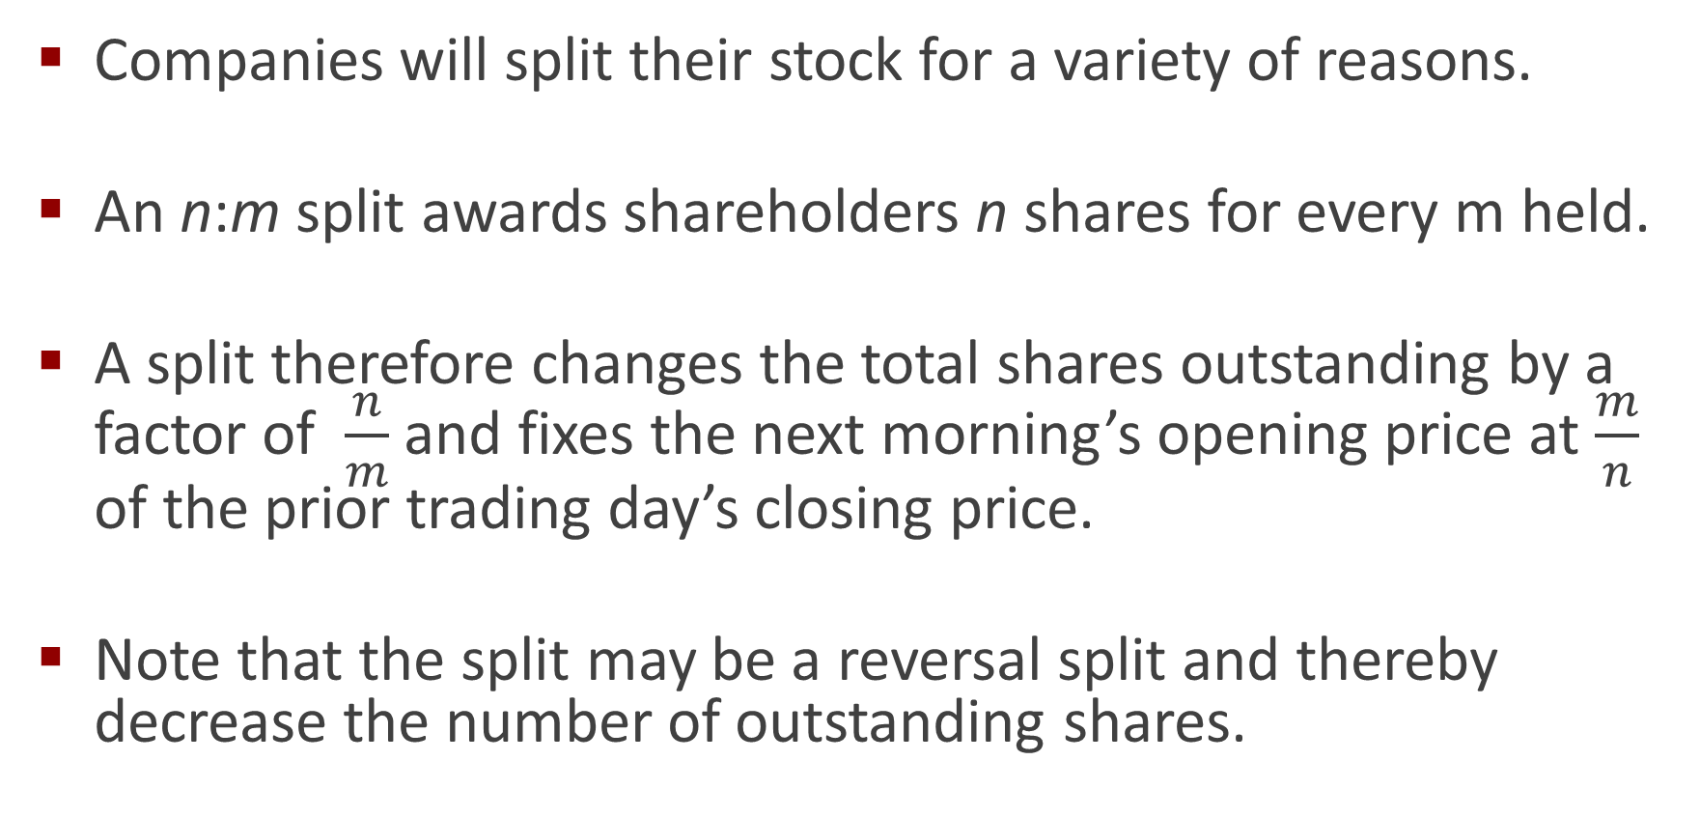
Preparing Data: Adjusting Prices
Companies will split their stock for a variety of reasons.
An n:m split awards shareholders n shares for every m held.
A split therefore changes the total shares outstanding by a factor of $\frac{n}{m}$ and fixes the next morning’s opening price at $\frac{m}{n}$ of the prior trading day’s closing price.
Note that the split may be a reversal split and thereby decrease the number of outstanding shares.

Slide 12
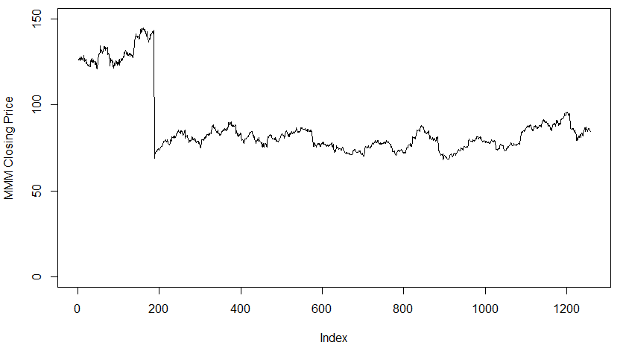
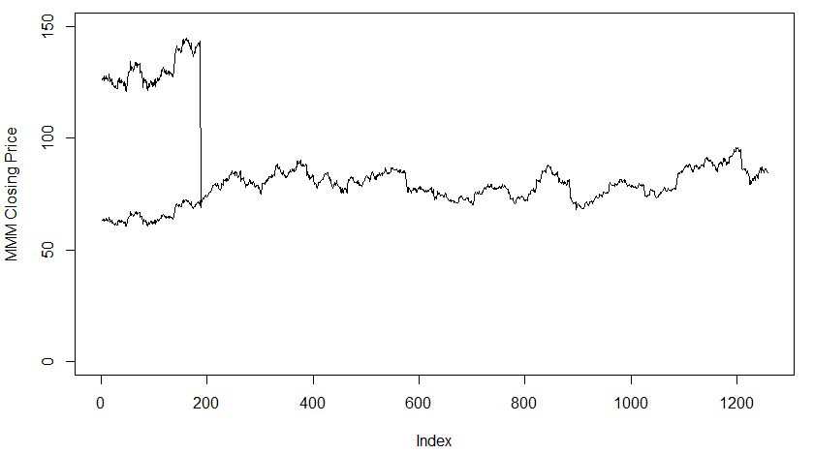
MMM: Comparing Adjusted to Unadjusted Prices

Slide 13
A Comment on Closing Prices
If we adjust for closing prices to account for splits and dividends, why use/keep the unadjusted closing prices
If we want to decompose returns into price returns and dividend returns
If we want to do any calculations based off the closing price – the adjusted closed may not be compatible – i.e. strike prices for options
If we want to make allocation/rebalancing decisions based on the price of the stock – we will need the unadjusted close

Slide 14
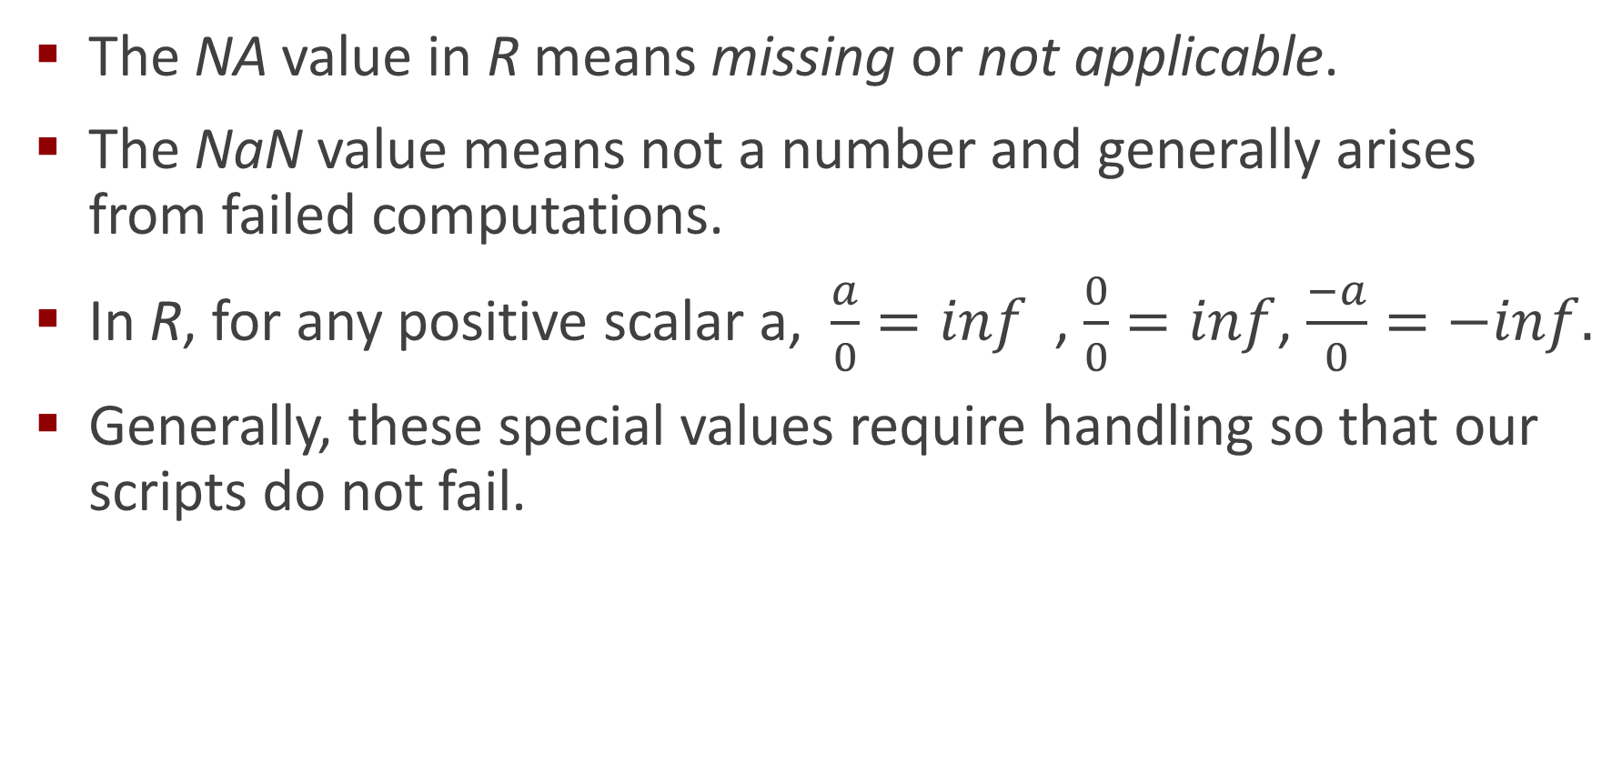
Invariably, the Data Will Have Missing Values
The NA value in R means missing or not applicable.
The NaN value means not a number and generally arises from failed computations.
In R, for any positive scalar a, $\frac{a}{0}=inf$ , $\frac{0}{0}=inf$, $\frac{−a}{0}=−inf.$
Generally, these special values require handling so that our scripts do not fail.

Slide 15
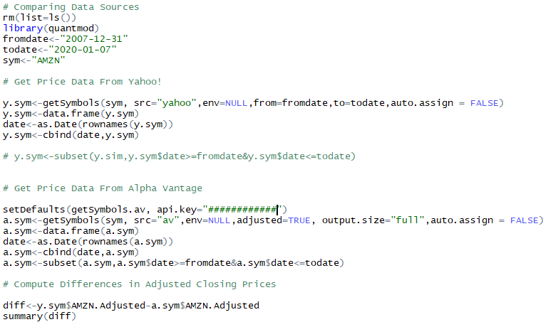
Invariably, Some of the Data will be Inaccurate
Comparing pricing data from Yahoo and Alpha Vantage for Amazon stock.

Slide 16
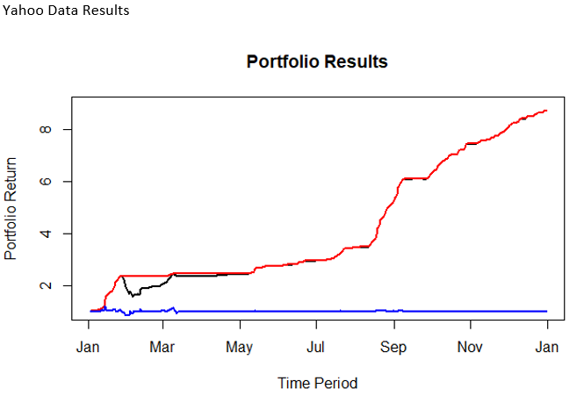
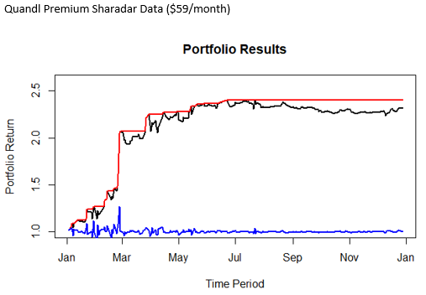
Strategy Performance with Two Different Data Sources

Slide 17
Using APIs to Collect Data
An API is an Application Programming Interface.
Basically, an API is a package in R that will allow registered subscribers to automatically download data.
Quantmod and Quandl are packages that have many useful built-in functions, including the ability to download data from selected sources.
The key function for downloading data is getSymbols in Quantmod and Quandl.datatable in Quandl.

Slide 18
Get a Nasdaq Data Link Account & Buy a Subscription
https://data.nasdaq.com
Purchase the Sharadar Equity Bundle. The academic price is $59/month. You need to use your “.edu” email address.
Technically you will need at most 2 months. February and April.
The bundle has standard OHLCV, plus insider activity, fundamental data, and more.
Please also see the corresponding video titled: Creating a Nasdaq Link Account (and Subscribing to a Data Service).

Slide 19
Class Workshop : Create an S&P Stock Universe
Universe of S&P stock symbols are in SP Tickers.csv.
Make a Quandl API call using the Sharadar Equities bundle.
Use the SEP database – sharadar equity prices.
Use a for loop to obtain and process each symbol
Collect data for all five years of historical data available to you.
Use an error handler (tryCatch) to catch invalid symbols/errors during download
Be sure to:
Remove rows where the date is prior to the symbol’s addition to the S&P.
Remove rows where the date is after the symbol’s removal from the S&P.
Keep the adjusted values for open, high, low, close, and volume, plus the unadjusted close.
Create a single dataframe repository for all stocks

